Slide 1

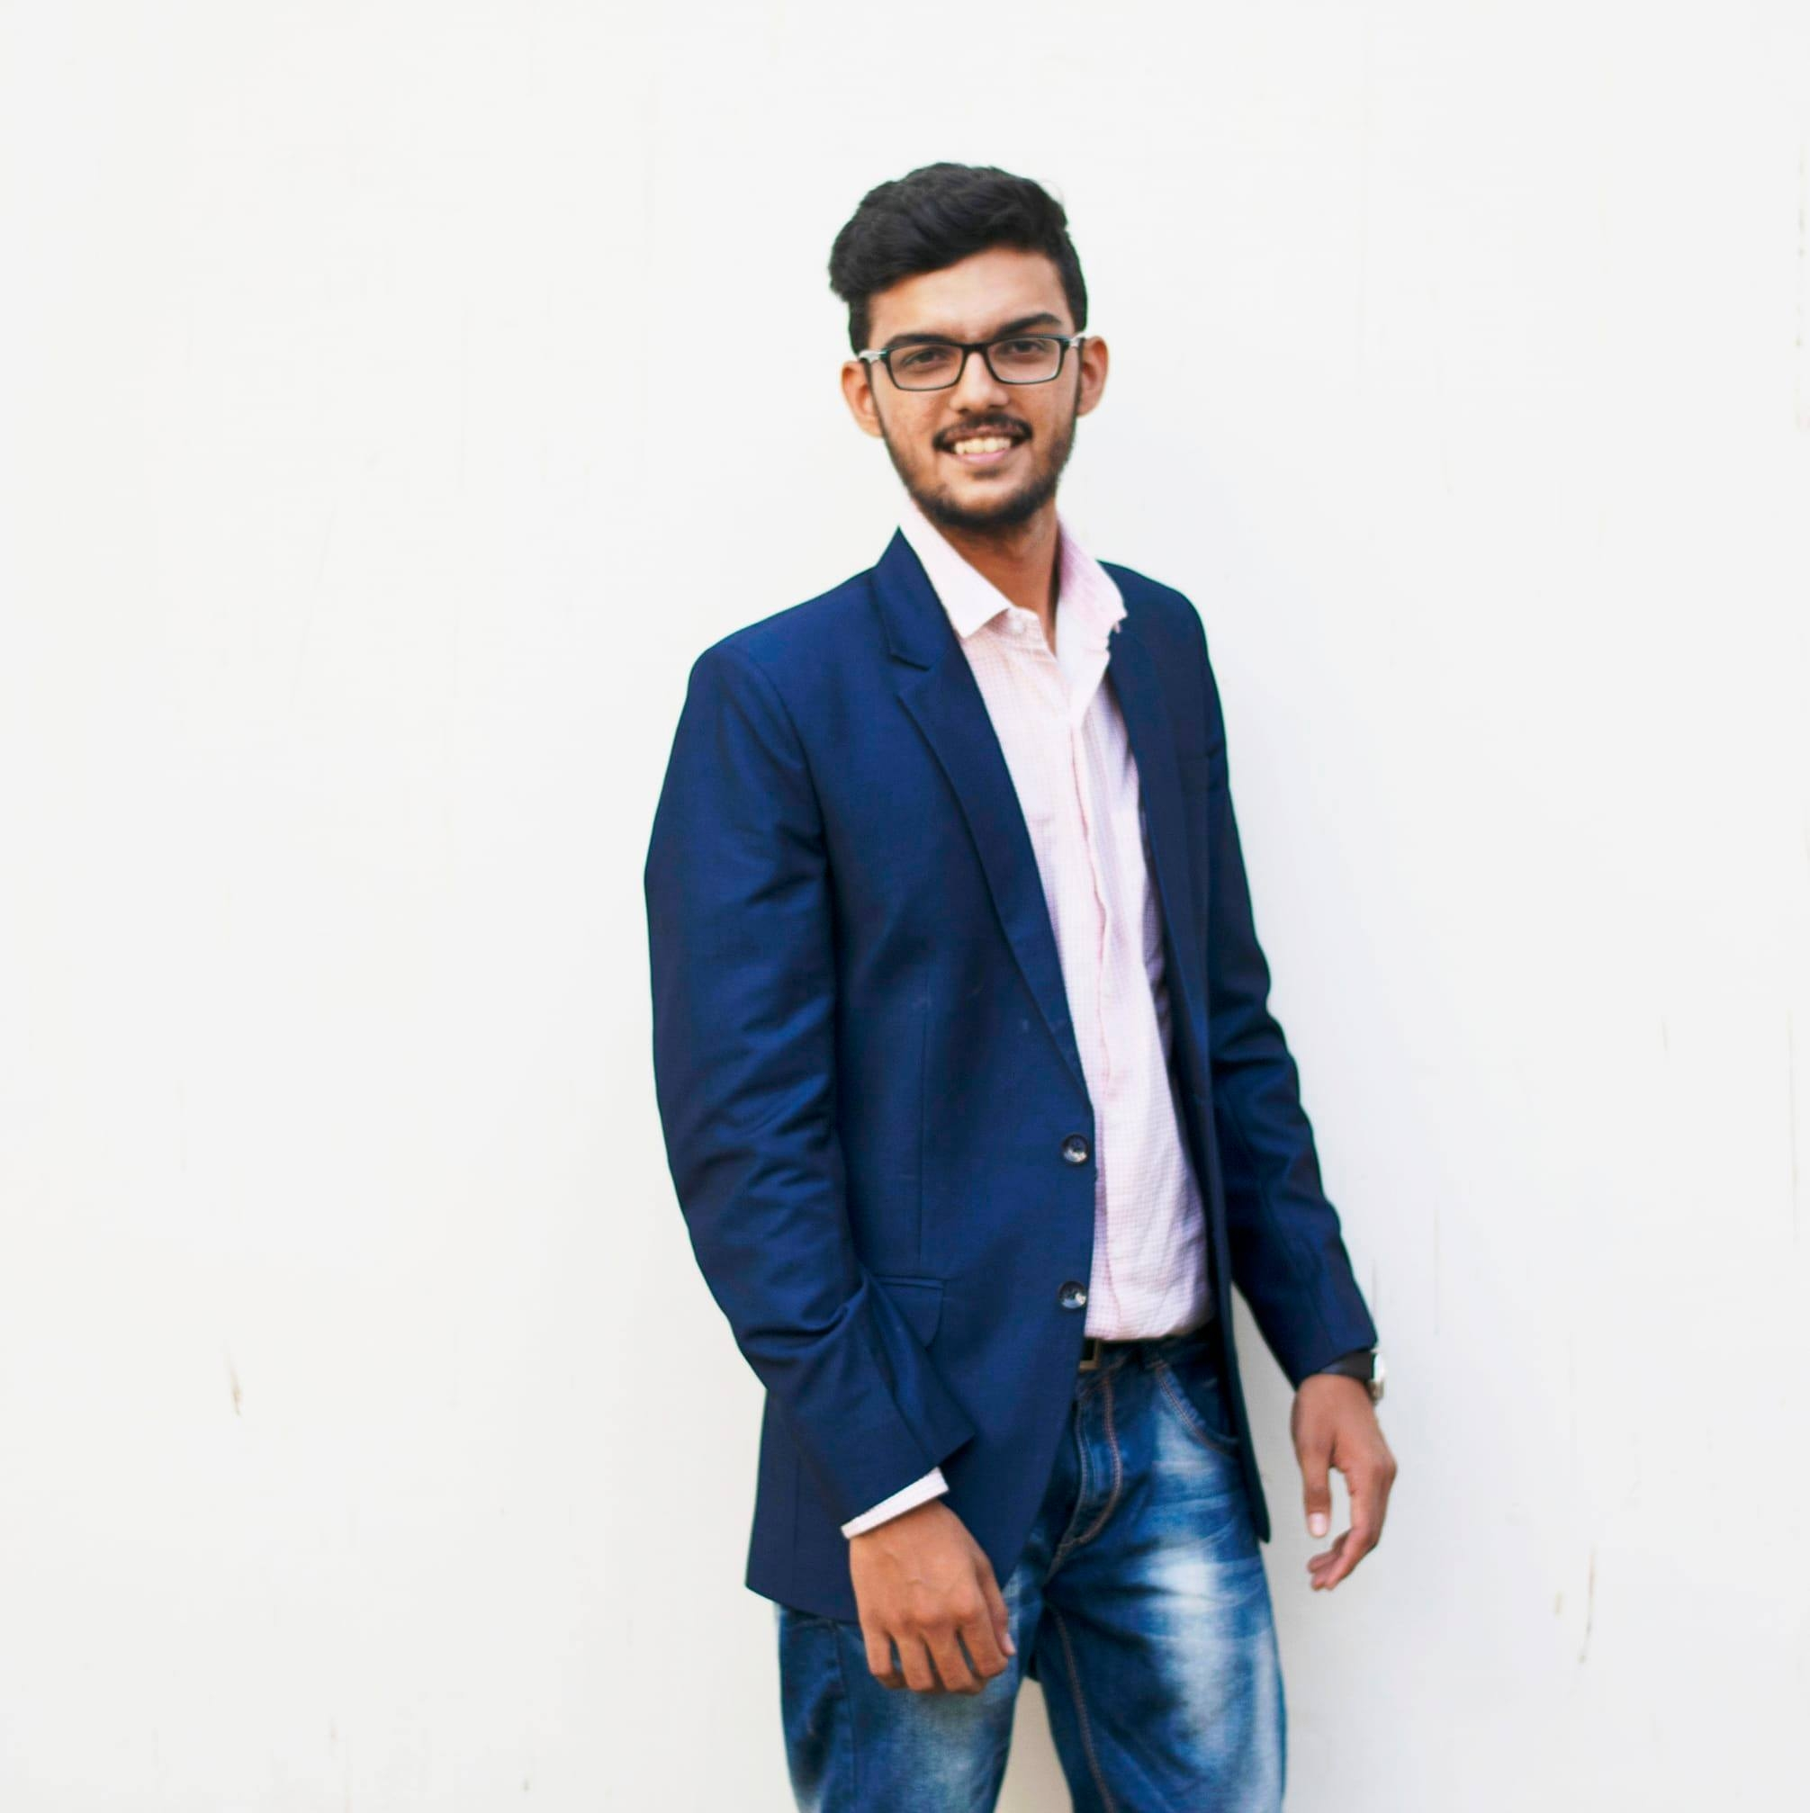
Image
Building on belief
Ruchit Desai
Analyst
Qualifications
User Experience Design
Agile working method
Web Development
IT Project Management
Languages: English(Native), German(Upper Intermediate)
Focus Skills
Design Thinking
UX Design, Customer Experience
Full Stack Development
IT Project Management
Additional Competencies, Education & Professional Career
Bachelors of Engineering in Computer Science.
M.Sc. Applied Computer Science
Design Thinking Certification.
UX Design certification.
Languages and framework: Java, JavaScript, HTML, CSS, Vue.js, OpenCV.
Design Tools: Sketch, Figma.
Agile E1 Certification
Project Experience
User Interface Designer: Made some use cases and interfaces for the project "Smart Network" which basically was made to display Instagram and Facebook on a single page to remove the navigation feature which users did while changing from one platform to other.
Deutsch Bank (May 2022 – May 2023): Made wireframes as an analyst to help developers develop the code. Also carried functional tasks like evaluation of budget for a project and as an analyst, analyzed the code to process further with the requirement.
Focus Industries & Areas
Software Development
Product and Project Management
Cyber Security

